Slide 1
A sample program for the SSOS: Material Flow Simulation

Slide 2
Overview
Our company SSD has developed SICLE (Simulator for Closed Life and Ecology), a Java-based software that enables users to create and simulate material circulation models. In this instance, we are providing a Python-based sample of simulation software that visualizes material flow for Space Station OS (SSOS). While the functionality is currently limited, we hope this sample serves as a useful introduction.
Reference:
Space Station OS >Discussions > ECLSS technical discussions
ID: diana1218, SSOS-SSD デモ.pdf
https://github.com/orgs/space-station-os/discussions/19?sort=new

Slide 3
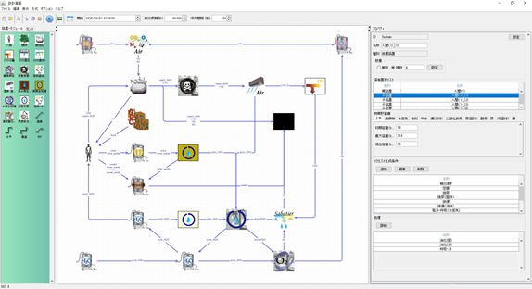
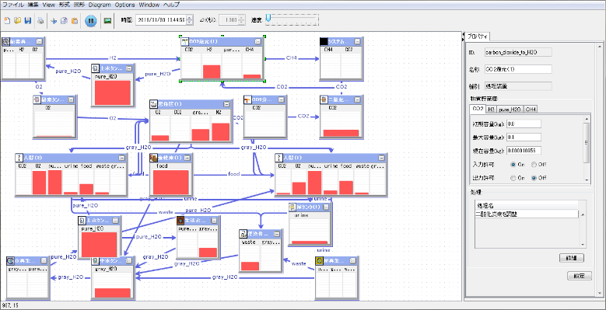
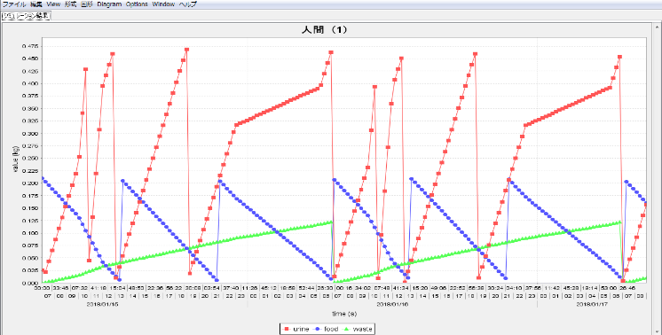
About SICLE(java)
①The design interface allows users to create material circulation models by freely adding humans, devices, and tanks, each defined according to specific parameters.
②Users can set numerical values, define processing details, choose the simulation period, and run the simulation. The simulation screen tracks the fluctuations in substance levels within each device.
③Results can be analyzed in detail through CSV data and other outputs. Based on the findings, users can adjust models, values, or processing parameters and rerun the simulation.
Through THE simulations, users can gather valuable insights into whether a proposed model supports effective material circulation, assess device scale, tank capacities, and more.
②SILCE simulation screen
③SILCE results
①SILCE design screen

Slide 4
Function Comparison
 | SICLE (java) | Sample model (python)
Model of material cycle | Freely creatable (Define the equipment and substances in a separate sheet.) | Fixed as described in next page (Only the contents written in code.)
Code | unpublish | publish
Model design screen | Available | Not available
Duration of simulation | Set freely | Only 30days or 100days
Output csv data | ・Amount of substance within each device ・Information of input/output ・Increase/decrease of substances in each device 3 csv data The data acquisition interval can be select per minute, per hour, per day. | ・Amount of substance within each device Only 1 csv data The data acquisition interval is only every hour.
Software to be sell. While SSD have extensive expertise with SICLE (Java).Please understand that sample model (python) has very limited functionality as it is a sample intended for SSOS.

Slide 5
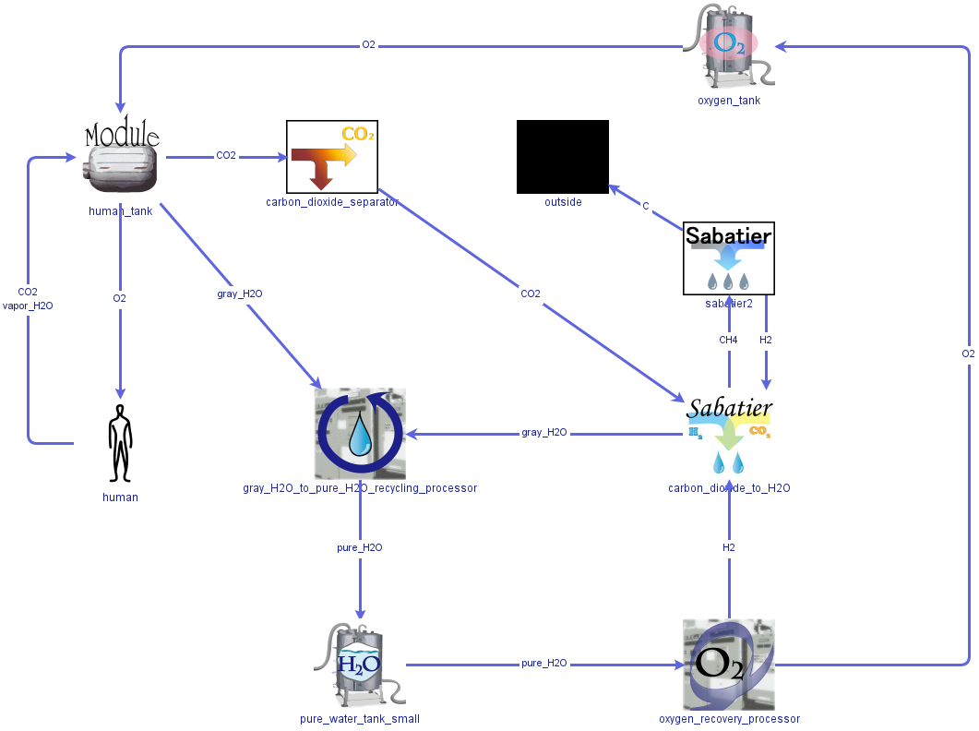
About sample model in python
[configuration]
・Crew：1
・Module：1
・Oxygen tank：1
・Pure water tank small：1
・Carbon dioxide separator：1
・Carbon dioxide to water system：1
・Sabatier 2 system：1
・Oxygen recovery processor：1
・Water recycling processor：1
・Outside：1
[コメント]
こちらのモデルは、宇宙での物質循環としては不十分のモデルであることは認識しています。今回はSSOS向けサンプルとして、人間、空気、水のシンプルな循環を提供することが目的です。

Slide 6
Detail of sample model① initial value/maximum value
Example:
Oxygen tank
Initial O2 value
：100kg
Maximum O2 value
：150kg

Slide 7
Detail of sample model② processing
Example:
crew
Consumption of O2: 0.895kg/day, Emission of CO2: 1.085kg/day, Emission of Vapor_H2O: 2.946kg/day

Slide 8
Detail of sample model③ rationale of the figures
About ① (initial value/maximum value)
We conducted simulations and adjusted to the appropriate values.
About ② (processing)
Crew：Refer to *1
Module: We decided. (100% conversion to crew’s vapor water to gray water)
Carbon dioxide separator : We decided. (50% absorption of carbon dioxide)
サバチエ第一反応装置: We decided. (The ratio of molar mass was matched from the chemical formula.)
サバチエ第二反応装置: We decided. (The ratio of molar mass was matched from the chemical formula.)
水再生装置: We decided. (100% conversion to gray water to pure water)
酸素製造装置: We decided. (The ratio of molar mass was matched from the chemical formula.)
*1: Life Support Baseline Values and Assumptions Document, NASA/TP-2015-218570, Rev2
Table 3-31 Summary of Nominal Human Metabolic Interface Values

Slide 9
Results and Future
[Results]
A sample program in Python was developed for simulating material cycles. Verifications were consistent by comparing the results with those from the SICLE Java version. Thus, our work is now complete.
[Future]
Non
Extras：
-Developing Python-based simulation software that allows for freely creating models like SICLE in java will require additional development costs. -We believe it would be beneficial to explore the potential use of the Space Station OS for private utilization of the ISS, alongside our simulation technology, including considerations related to funding.

Slide 10
Contact
・We will answer any questions about the submitted sample program in Python on GitHub.
・If you have any questions about SICLE in java or are interested in the trial version, please contact us at the following.
＞＞＞SICLEのお問い合わせ先を作成できませんか？（以下のイメージ）
sicle_simulation@space-sd.co.jp
宇宙システム開発株式会社 Space Systems Development Corporation
https://space-sd.co.jp/

